Slide 1

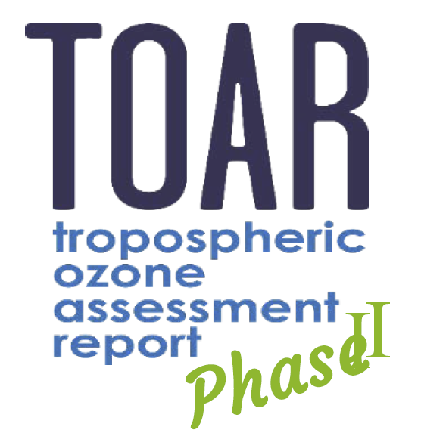
Tropospheric Ozone Assessment Report Phase II (TOAR II)
East Asia Focus Working Group
(EAWG)
Kick-off meeting (virtual)
May 13, 2021

Slide 2
Agenda
Introduction of TOAR and EAWG (Lin Zhang, Peking University; Xiao Lu, Sun Yat-sen University)
Introduction of EAO3 database (Ke Li, Harvard; Ja-Ho Koo, Yonsei University)
Introduction of EAWG modeling activity (Xiao Lu; Tatsuya Nagashima, NIES)
Introduction of EAWG members (EAWG members)
Open discussion

Slide 3
1.Introduction of TOAR and EAWG

Slide 4


TOAR-I (2014-2019) Mission and deliverables
Mission:
To provide the research community with an up-to-date scientific assessment of tropospheric ozone’s global distribution and trends from the surface to tropopause.
Deliverables:
1) The first tropospheric ozone assessment report based on all available surface observations, the peer-reviewed literature and new analyses.
2) A database containing ozone exposure metrics at thousands of measurement sites around the world, freely accessible for research on the global-scale impact of ozone on climate, human health and crop/ecosystem productivity.
https://igacproject.org/activities/TOAR/TOAR-I

Slide 5
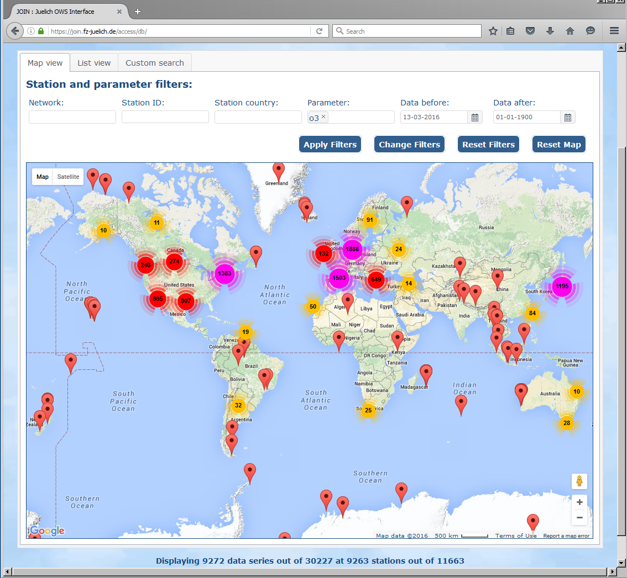
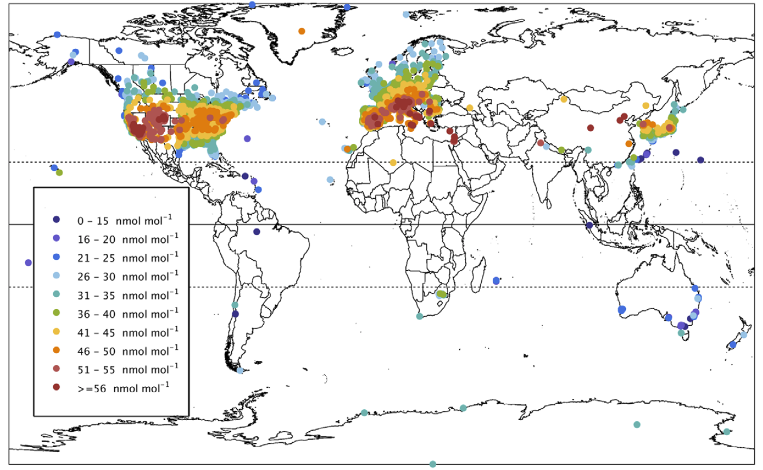
TOAR-I (2014-2019) Achievements
Open-access TOAR-I ozone database
First global-scale view of surface ozone
(9 highly cited publications in Elementa)
JJA daytime average ozone, 2010-2014, TOAR I
https://join.fz-juelich.de/
[Gaudel et al., 2018, Elementa]

Slide 6
TOAR-II (2020-2024) Goals
TOAR Ozone Data Portal: Update the ozone observations in the TOAR surface ozone database to include all recent observations (since 2014), and include data from new sites and regions, as well as ozone precursor and meteorological data. Develop methods for including historical data (pre-1975) and create working links to repositories of free tropospheric observations.
TOAR publications: Exploit the new observational datasets collected by Goal 1 (with data through 2020) to provide an updated state of the science estimate of ozone’s global distribution and trends relevant to climate, human health and vegetation. Extend the statistical toolbox and metrics of the TOAR trend analyses. These results will be published in the open-access, peer-reviewed literature.
Involve scientists from the atmospheric sciences community, as well as statisticians and scientists who focus on broader issues of global change and sustainability, to identify outstanding science questions in relation to tropospheric ozone. The range of topics can be expanded beyond the scope of the original TOAR effort to investigate the impacts of tropospheric ozone on climate, human health and vegetation, and to address urban-scale issues in addition to the regional and global scale.
Maximize exploitation of the TOAR Surface Ozone Database by, 1) helping scientists around the world, beyond the TOAR effort, to apply the database to new analyses, and 2) exploring new data science methods to improve the analysis of global ozone trends and their attribution.
https://igacproject.org/activities/TOAR/TOAR-II

Slide 7
TOAR-II (2020-2024) Chairs and Working Groups
Dr. Owen R. Cooper
CIRES University of Colorado/NOAA Chemical Sciences Laboratory, Boulder, CO, USA
Dr. Martin G. Schultz
Forschungszentrum Jülich, Germany
11 Steering Committee members
10 Working Groups
Chemical Reanalysis Focus Working Group
East Asia Focus Working Group
HEGIFTOM Focus Working Group (Harmonization and Evaluation of Ground Based Instruments for Free Tropospheric Ozone Measurements )
Ozone over the Oceans Focus Working Group
Ozone and Precursors in the Tropics (OPT) Focus Working Group
Radiative Forcing Focus Working Group
Satellite Ozone Focus Working Group
Statistics Focus Working Group
Tropospheric Ozone Precursors (TOP) Focus Working Group
Urban Ozone Focus Working Group

Slide 8
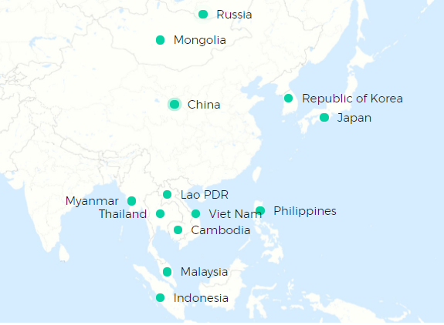
TOAR-II EAWG Motivation: ozone over EA was not well characterized in TOAR I
The East Asia region
JJA daytime average ozone, 2010-2014, TOAR I
https://www.eanet.asia/
[Gaudel et al., 2018, Elementa]

Slide 9


TOAR-II EAWG Challenges and priorities in ozone study over East Asia
Data collections
Surface/free tropospheric ozone observations are sparse.
Auxiliary/supporting data (precursor measurements, meteorological parameters/emission inventory, etc.) are poorly collected or shared.
Ozone trend attributions and global impacts
Ozone trends in East Asia are not well understood, models fail to capture the trends and disagree with each other on the trend attributions.
Global impacts of ozone change in East Asia need to be re-evaluated.

Slide 10
TOAR-II EAWG Goals
Goal 1: Construction of the EAO3 database
Ozone measurements from the surface to free troposphere.
Auxiliary data, including in-situ meteorological data, ozone precursor and aerosol measurements, gridded anthropogenic and natural emissions, geographic data, etc.
Goal 2: Quantification of factors driving EA ozone trends
Quantify climatic and chemical factors driving EA ozone trends over East Asia, reconciling the results from different methods (statistics/CTMs/ML) using the same (similar) data source in EAO3 database.
Goal 3: Quantification of global influences of EA ozone and precursors
Quantify the influences of East Asia ozone and precursor outflow on intercontinental ozone transport, the global ozone budget, and radiative forcing.

Slide 11
TOAR-II EAWG Team: 4 co-chairs and 26 members from 9 countries/regions
Surface measurement; Ozonesonde; Satellite; Model
China:
Jianlin Hu (Nanjing University of Information Science and Technology)
Xin Huang (Nanjing University)
Junli Jin (China Meteorological Administration)
Yiming Liu (Sun Yat-sen University)
Keding Lu (Peking University)
Lu Xiao (Sun Yat-sen University, co-lead)
Xiaobin Xu (China Meteorological Administration)
Wanyun Xu (China Meteorological Administration)
Likun Xue (Shandong University)
Hong Kong:
Meng Gao (Hong Kong Baptist University)
Hai Guo (The Hong Kong Polytechnic University)
Xiaopu Lyu (The Hong Kong Polytechnic University)
Tao Wang (The Hong Kong Polytechnic University)
Junichi Kurokawa (Asian Center for Air Pollution Research)
Tatsuya Nagashima (National Institute for Environmental Studies, co-lead)
Keiichi Sato (Asian Center for Air Pollution Research)
Seiji Sugata (National Institute for Environmental Studies)
South Korea: Juseon Bak (Pusan National University)
Dongwon Lee (National Institute of Environmental Research)
Mee-Hye Lee (Korea University)
Joowan Kim (Kongju National University)
Ja-Ho Koo (Yonsei University, co-lead)
USA: Yuqiang Zhang (Duke University)
Lu Shen (Harvard)
Ke Li (Harvard, co-lead)
Malaysia: Mohd Talib Latif (Universiti Kebangsaan Malaysia)
Thailand: Kasemsan Manomaiphiboon (King Mongkut’s University of Technology Thonburi)
Pornpan Uttamang (Maejo University)
Vietnam: Nguyen Tran Huong Giang (Da Lat University)
Germany: Bing Gong (Jülich Supercomputing Centre)
Japan:

Slide 12
2. Introduction of EAO3 database to achieve Goal 1

Slide 13
TOAR-II EAWG Goal 1: Construction of the EAO3 database
To produce a full database for ozone research in East Asia and beyond:
Ozone dataset
Ozone from the surface to tropopause (ozonesonde/lidar, aircraft, satellite), providing full pictures of ozone over EA.
Precursors dataset
NO_{x}, CO, VOCs, PANs, PM_{2.5} from site observations, field campaigns, and satellite observations, supporting study on ozone chemistry, model validation, etc.
Meteorology dataset
In situ observations of meteorological parameters, supporting O₃-meteorology relationship studies and modeling activities.
Emission dataset
Include anthropogenic and natural emissions for supporting modeling (CTM/statistical/ML) activities.

Slide 14
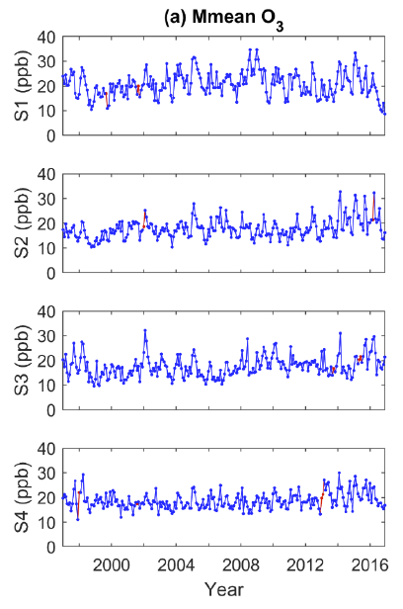
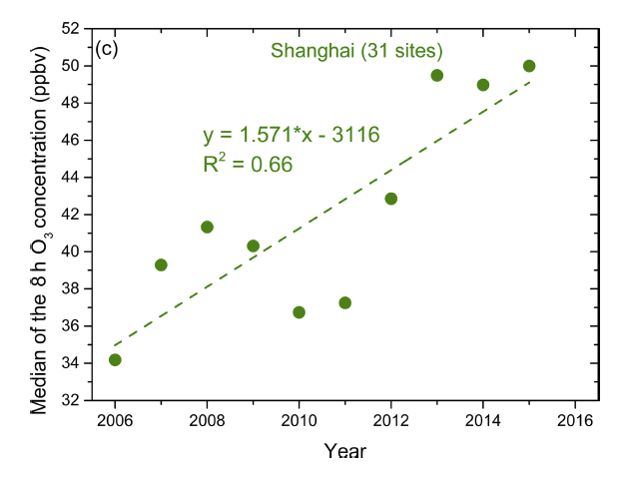
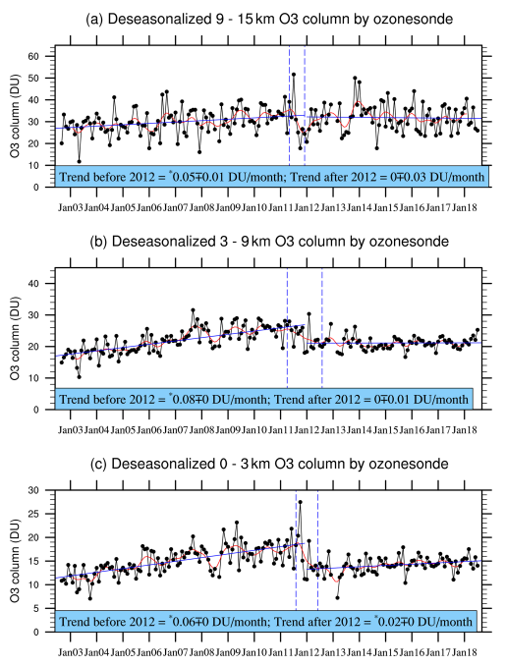
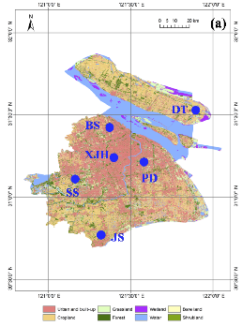
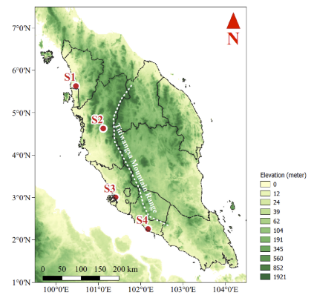
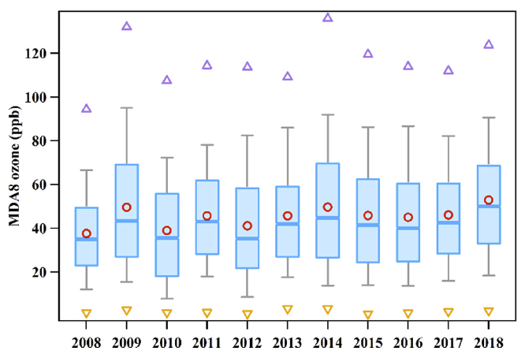
TOAR-II EAWG Goal 1: Construction of the EAO3 database
Examples of EA ozone measurements not included in the nationwide monitoring network (Table A1)
20-year surface ozone in
Malaysia
15-year surface ozone in
Shanghai/Guangzhou
15-year tropospheric ozone in
Beijing
[Ahamad et al. 2020]
[Xu et al. 2019; Yin et al., 2019]
[Zhang et al., 2020]

Slide 15
Highlight: ozonesonde measurement plan in South Korea
TOAR-II EAWG Goal 1: Construction of the EAO3 database
Plan 2021 at Anmyeondo
JUL-AUG: ~30 launches for the pre-ACCLIP and GEMS validation
(ACCLIP: Asian Summer Monsoon Chemical and Climate Impact Project by NCAR and NASA)
SEP-OCT: ~20 launches for the domestic monitoring with NIER
(NIER: National Institute of Environmental Research, Korea)
OCT: preliminary results will be presented in the Quadrennial Ozone Symposium (QOS). 3-9 October (qos2021.yonsei.ac.kr)
Seoul
Anmyeondo
(WMO-GAW station)
Pohang
(KMA station)
Plan 2022 at Anmyeondo
MAY-JUN: ~20 launches for the domestic monitoring with NIER
(comparison to the findings during the Korea-US Air Quality campaign, KORUS-AQ, in 2016)
JUL-AUG: ~30 launches for the main ACCLIP and GEMS validation
Jeju island
Anmyeondo Station
Plan at Pohang
Launching about every week since 1995.
Joowan Kim, Kongju U. (member of EAWG)
Ja-Ho Koo, Yonsei U. (Co-chair of EAWG)

Slide 16
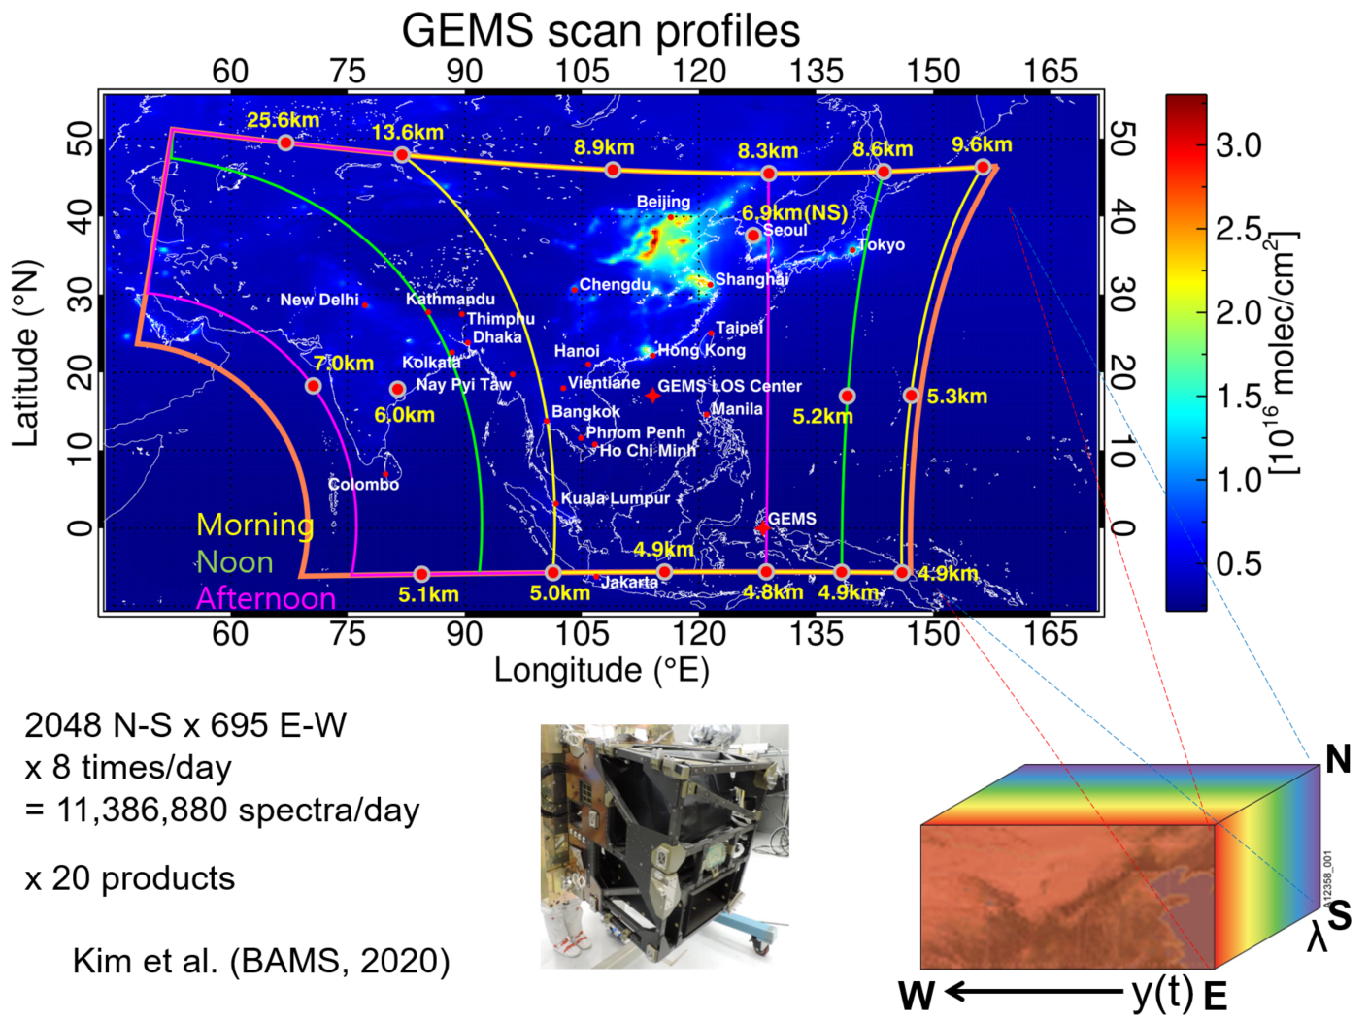


Highlight: Geostationary Environment Monitoring Spectrometer (GEMS)
TOAR-II EAWG Goal 1: Construction of the EAO3 database
Inter-comparison
(Courtesy of Jae-Hwan Kim, Pusan national Univ.)
Total column ozone (TCO)
X: Brewer obs. Y: pre-GEMS
(2004-2008)
Ozone profile
X: ozonesonde obs. Y: pre-GEMS
(2005-2006)
Time table:
Spring 2021: Total column ozone data will be released.
Spring 2022: Tropospheric ozone and ozone profiles will be released.
Juseon Bak, Pusan National U. (member of EAWG and GEMS)
Dongwon Lee, NIER Korea (member of EAWG and GEMS)
Ja-Ho Koo, Yonsei U. (Co-chair of EAWG and member of GEMS)

Slide 17
Data Requirement and Credit Statement
To acknowledge the EAO3 data providers and make the dataset accessible to a wide range of users, the following guidelines are recommended:
Data requirement
Ozone measurement:
(1) Raw data with quality control would be preferable
(2) Post-processed data with common metrics (e.g. MDA8 ozone) are also acceptable.
(3) Ozone precursor species and meteorological parameters along with surface ozone measurement should follow (1) or (2).
Satellite products:
Processed gridded data (Level 3) would be preferable, and links of Level 2 data repositories should be provided.
Field campaign data:
Descriptions of data and PIs contacts should be provided at least.
Emissions/Meteorology/Others:
Links and descriptions of data repositories or PIs contacts should be provided at least.

Slide 18
Data Requirement and Credit Statement
Credit statement
Download of EAO3：
We are proposing three levels for data sharing, which is applicable to all the measurement data in the EAO3 database.
Level 1: Users can freely download the data without further notice to data provider;
Level 2: Users can freely download the data but need to notify the data provider and make acknowledgement in their publications;
Level 3: Users must contact the data provider for any use before they can download the data.
For the publication of any TOAR assessment report contributed by our WG:
We are happy to provide authorship on the TOAR II publications once the data are accepted in the EAO3 database.
For any other publications:
(1) In case of using data with Level 1 or Level 2, there is no requirement but it is suggested to offer co-authorship to data providers if EAO3 data contributes a lot to your work.
(2) In case of using data with Level 3, it is determined by the data providers if a co-authorship is needed.
(3) If the EAO3 data are a principal component of the publications, then co-authorship should be offered to the data providers.

Slide 19
3. Introduction of modeling activities to achieve Goals 2 and 3

Slide 20
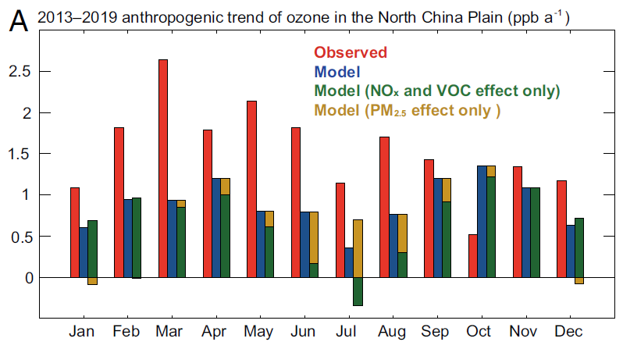

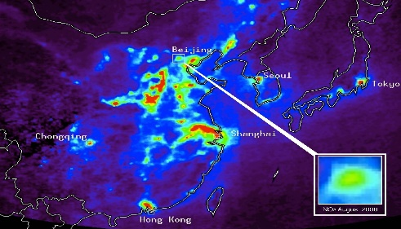
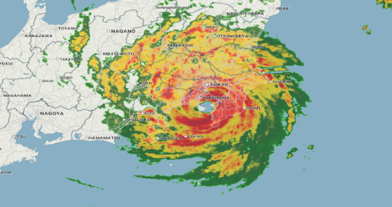

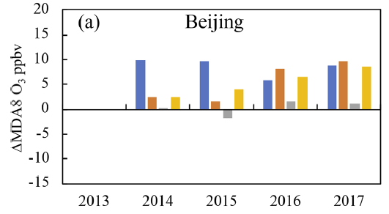

TOAR-II EAWG Goal 2: Quantification of factors driving EA ozone trends
Key questions to be answered:
What causes the model biases/discrepancies in capturing short-term/long-term ozone trends over EA?
What are the relative contributions of chemical vs. climatic factors to ozone trends? Can we reconcile the results from different methods?
EAO3 database
Different modeling tools
O₃ trend attributions
Statistical models
Ozone
Precursors
Machine learning
methods
[GEOS-Chem, Li et al. 2021, PNAS]
Meteorology
Emissions
Chemical model simulations
[WRF-CMAQ, Liu et al., 2020, ACP]

Slide 21
TOAR-II EAWG Goal 3: Quantification of global influences of EA O₃ and precursors
Key questions to be answered:
What are the short-term and long-term contributions of EA emissions to air quality downwind, global ozone budgets, and radiative forcing?
EAO3 database
Modeling tools
EA ozone influences on:
Downwind air quality
Ozone
Precursors
Chemical (global) model simulations
Global ozone budgets
Meteorology
Emissions
Ozone radiative forcing

Slide 22
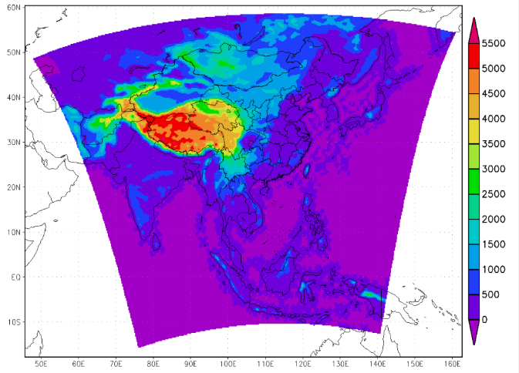
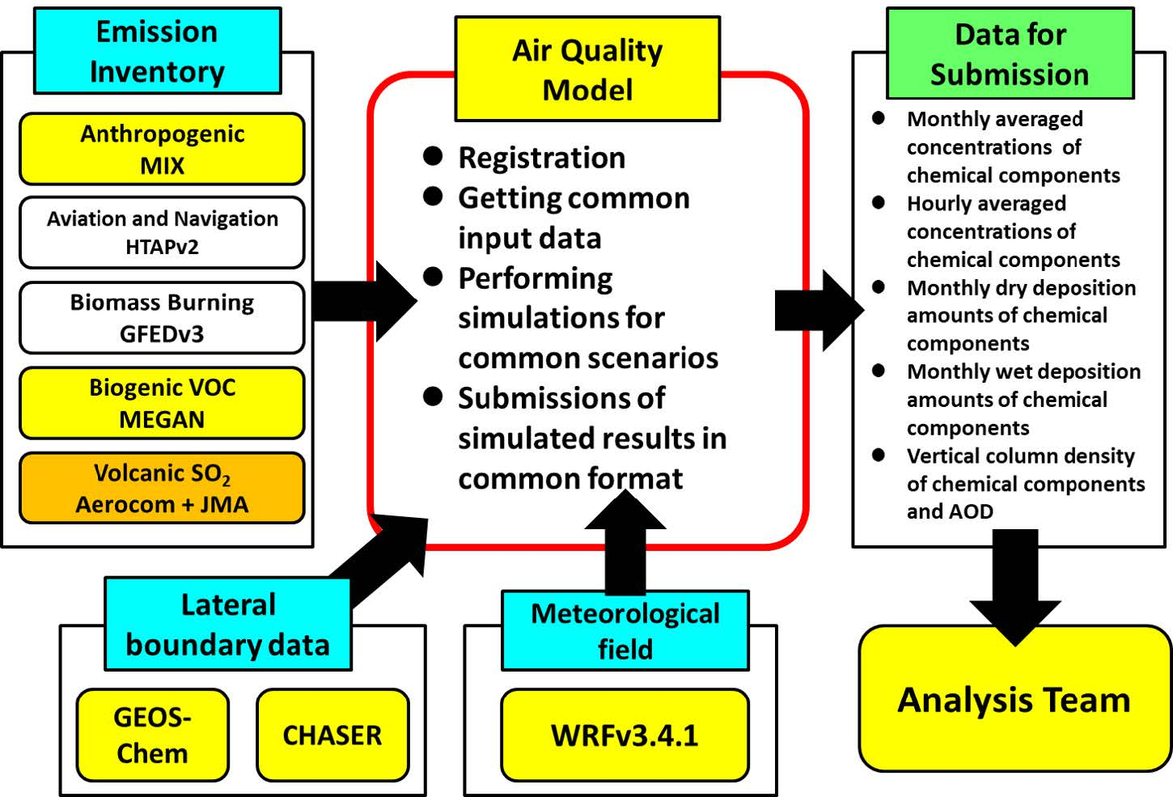
Model Inter-Comparison Study for Asia (MICS-Asia) Phase IV
TOAR-II EAWG Collaboration with MICS-Asia
Basic setup for MICS-Asia Phase III
Experimental design of MICS- Asia Phase IV is now under consideration, but expected improvements from Phase III include
Finer model horizontal resolution
Updated Emission data
Updated chemical mechanisms in the models, and
More Observations to be compared
Model domain
Δx = 45km
Linkage to TOAR-II EA-WG
Surface monitoring data
Vertical profiles
Satellite data
Chemical reanalysis data
Tatsuya Nagashima, NIES, Japan
Co-chair of EAWG and core member of MICS-Asia

Slide 23
TOAR-II EAWG Modeling activities for supporting Goals 2 and 3
Category | Methods | Groups/Person
Regional ozone chemistry/transport | Multi-model assessment using MICS-Asia models | Tatsuya Nagashima (NIES)
Trend attribution | Statistical methods | Ke Li (Harvard)
Trend attribution (with focus on ozone extremes) | Statistical methods Machine learning methods | Lu Shen (Harvard)
Regional ozone chemistry/transport Trend attribution | CMAQ (regional) | Jianlin Hu (NUIST)
Regional ozone chemistry/transport Trend attribution | CMAQ (regional) | Yiming Liu (SYSU)
Regional ozone chemistry/transport Trend attribution /impacts on human health | WRF-Chem (regional) | Meng Gao (HK Baptist)
Regional ozone chemistry/transport Trend attribution | WRF-Chem (regional) | Xin Huang (NJU)
Trend attribution /impacts on global ozone | GEOS-Chem model CMIP6 models | Xiao Lu (SYSU)
Trend attribution / impacts on global ozone | CAM-Chem model | Yuqiang Zhang (Duke)
 |  | You!
Model configuration (duration, emissions, resolution etc.) is under design.

Slide 24

TOAR-II EA WG Expected outcome
The EAO3 database for supporting ozone research over East Asia.
A review/research article introducing the EAO3 database and overviewing ozone and precursor levels over East Asia.
A review/research article quantifying factors driving ozone trends over East Asia from different approaches.
A review/research article quantifying global influences of East Asian ozone and precursors.
Independent research articles from Working Group members making use of the EAO3 database and modeling results.

Slide 25
TOAR-II EA WG Opportunities for WG members
Participations in the WG will be acknowledged by the WG websites
Co-authorships of the WG research articles
Early use of EAO3 database and/or modeling results for your own research (need to comply with the WG data policy)
Special issue of “TOAR – East Asia ozone research” on academic journals is in the plan, and WG members will be welcome to contribute
Collaborations with WG members on other research topics

Slide 26
TOAR-II EAWG Roadmap
Complete CTM simulations for ozone trend attribution.
Compare the results from different approaches for ozone trend drivers.
Conduct CTM simulations to quantify the impacts of EA ozone.
Collect and compile the EAO3 dataset.
Discuss the Statistical/ML/CTMs setup.
Spring-Summer
2021
Spring-Summer
2022
Spring-Fall
2023
Fall-Winter
2021
Fall-Winter
2022
EAWG Kick-off meetings.
Outline EAO3 dataset categories.
Reach out and invite research groups who would be interested in providing ozone and auxiliary data or joining modeling activities.
Complete and release the EAO3 database.
Conduct and complete statistical analyses for ozone trend attributions.
Conduct CTM simulations for ozone trend attribution.
Wrap up results and prepare for publication.
Summit for publication by 1 September, 2023

Slide 27
4. Introduction from WG members

Slide 28

Introduction to Bing GONG
2021-05-13 I TOAR-II east Asia FOCUS WORKING GROUP Kick-off meeting

Slide 29
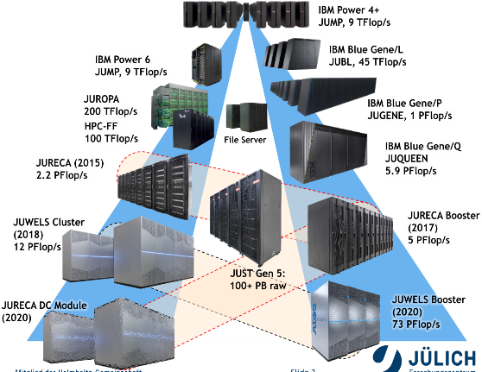
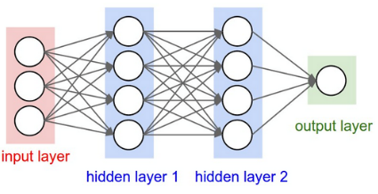
Jülich Supercomputing Centre (jsc)
19 Helmholtz Centres in Germany – We are One of Them
Objectives of JSC:
Develop the supercomputing facility towards Exascale (2023)
Complement the Exascale by a quantum computer facility JUNIQ
Develop federated data infrastructures and advanced data science
Provide most innovative support structures, tools, algorithms and methods
Educate a new generation of simulation and data science specialists

Slide 30


Earth System Data Exploration (ESDE)
Team members and research focus
ESDE :
Led by Martin Schultz
~ 20 members
~ Key expertise of ESDE
Deep Learning methods for atmospheric data (weather & atmospheric chemistry)
HPC system applications for Earth Science
Data management
~ 3 subgroups
Data infrastructures
AI for Air quality
AI for Weather and Climate
Bing Gong
Research focus:
AI in Air quality, and Weather
Distributed deep learning on HPC
Deep learning workflow tool development
Possible contributions:
statistical methods
machine learning methods
Bing Gong

Slide 31
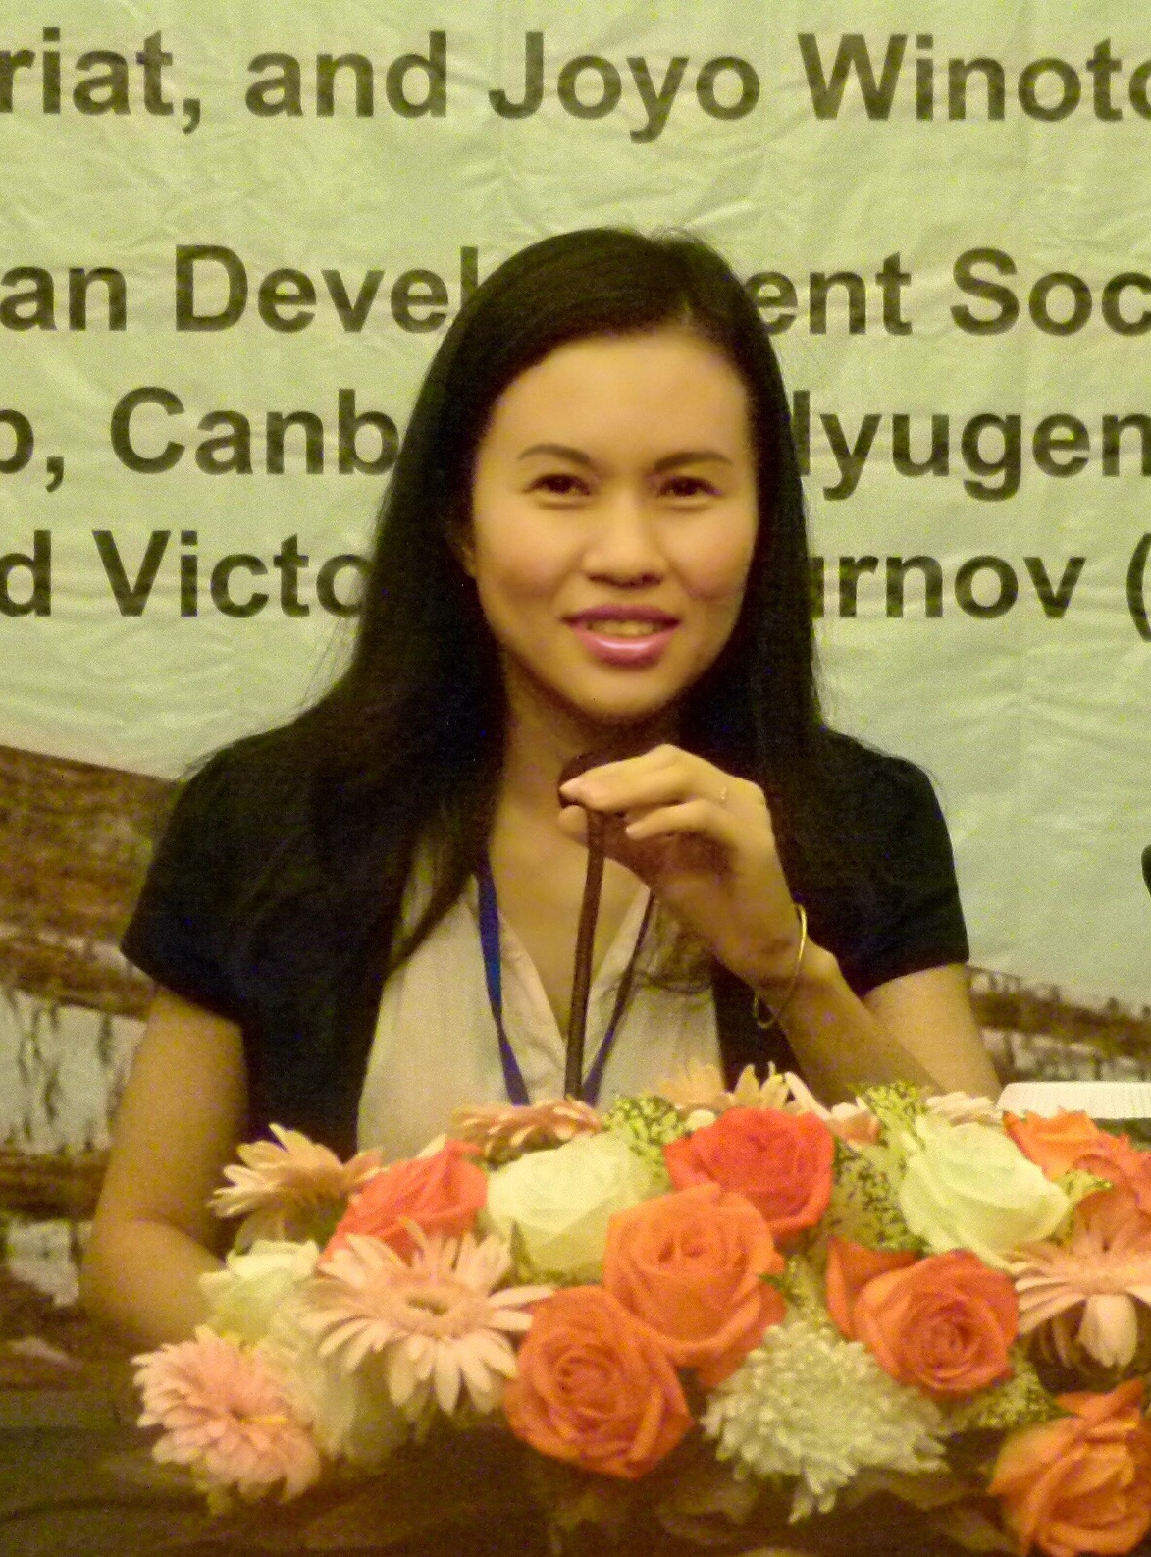
Self Introduction
Name: Nguyen Tran Huong Giang
Nationality: Vietnamese
Current position: Vice Dean
Faculty of Chemistry and Environment, Da Lat University
Education: PhD in Environmental Engineering (Osaka University, Japan)
Expertise: air quality modeling, air pollution assessment, environmental quality management
Recent works: aerosol direct effects in East Asia, and Continental Southeast Asia; future climate change and emission change impacting on PM_{2.5} and O₃ in Continental Southeast Asia

Slide 32
Possible contribution to the EAWG
Supporting in data collection in Vietnam
(O₃ , O₃ precursor species, meteorological parameters)
Disscusion on CTM model simulation design
(O₃ trend attribution, CMAQ)
Paticipating in CTM model output analysis and assessment
(O₃ trend attribution, CMAQ)
Participating in writing report

Slide 33
Something to discuss
Official document certifying member collaboration ?
Listing member names in the EAWG website ?
Member benefits ?

Slide 34
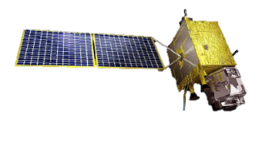

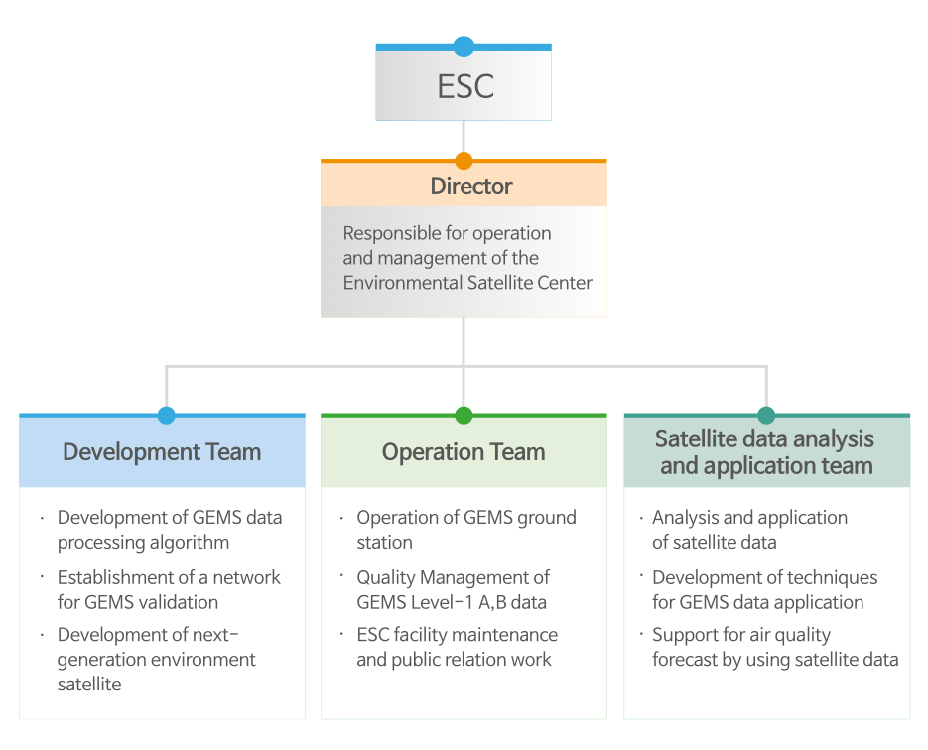
01
NESC
Establishment of National Environmental Satellite Center(NESC)
Organization
GEMS
Data
GOCI-2
Data
ESC is a new department for GEMS operation(Apr, 2018)
Located in National Institute of Environmental Research(NIER), Incheon, South Korea

Slide 35
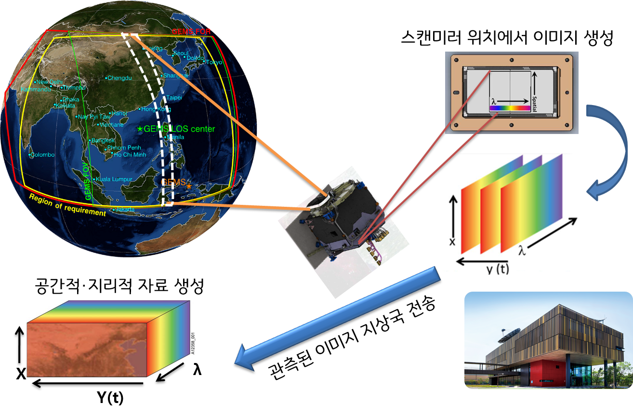
Status of GEMS products
02
Targeted gases | O₃, SO₂, NO₂, HCHO, CHOCHO, and aerosol, etc.
Lifetime | 10 Years
Spatial coverage | 5,000 km × 5,000 km (5 °S – 45 °N, 75 °E – 145 °E)
Spatial resolution | 7 km × 8 km @Seoul
Revisit time | 8 times / day
Spectral range / FWHM | 300 – 500 nm / 0.6 nm
Orbit / Altitude / Longitude | Geostationary earth orbit (GEO) / 35,786 km / 128 °E
Create Image on CCD
Spatial, geographic data
Observed data Transfer
to ground station
Timeline of ESC activities
NIER IOT
`20.2.19
Launch GK-2B
`20.4
GEMS Activation
`20.7
`20.10
`21.3.22
Start Web Service
(only image, 8 products)
`20.3
Reached Geostationary Orbit
IOT of ground station
and L1/L2 algorithms
`20.11.18
First release
GEMS image
`20.5~10
Instrument IOT(KARI)

Slide 36
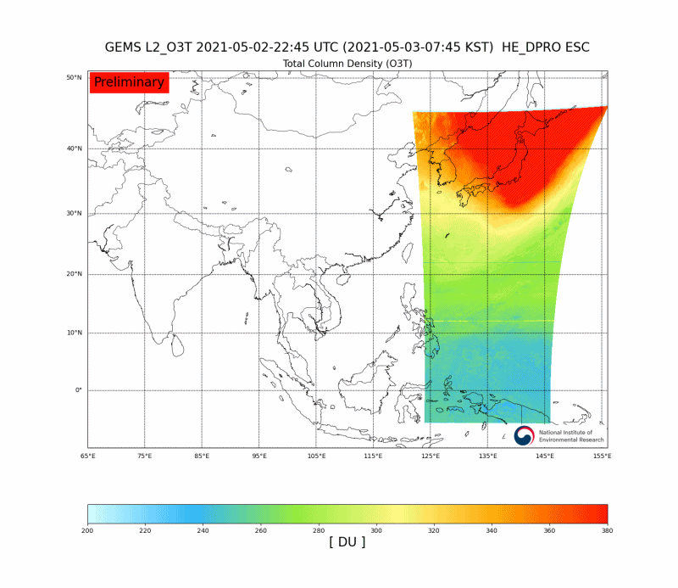
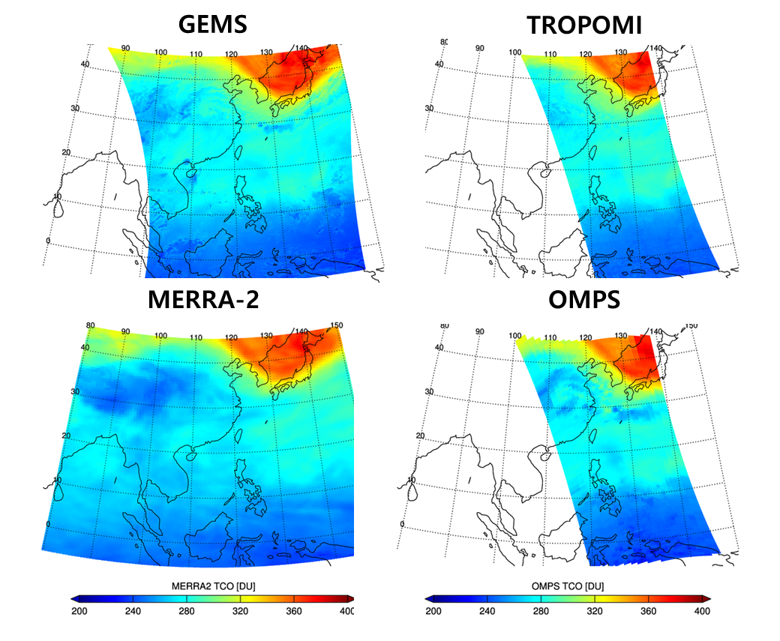
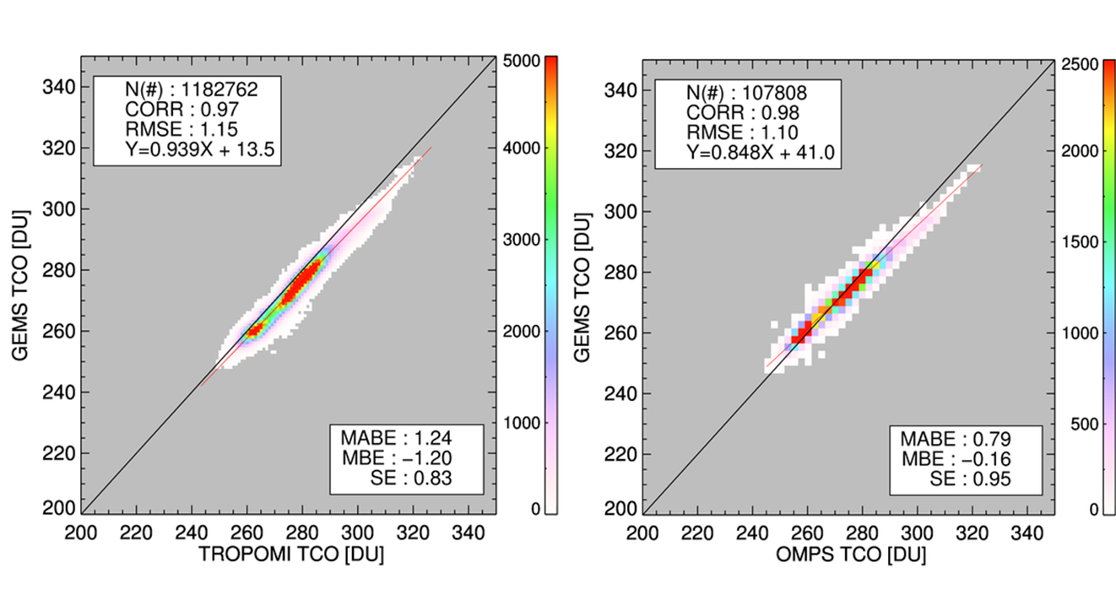
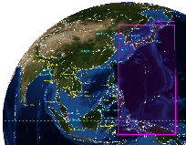
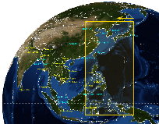
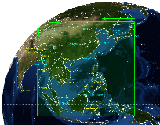
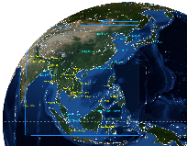

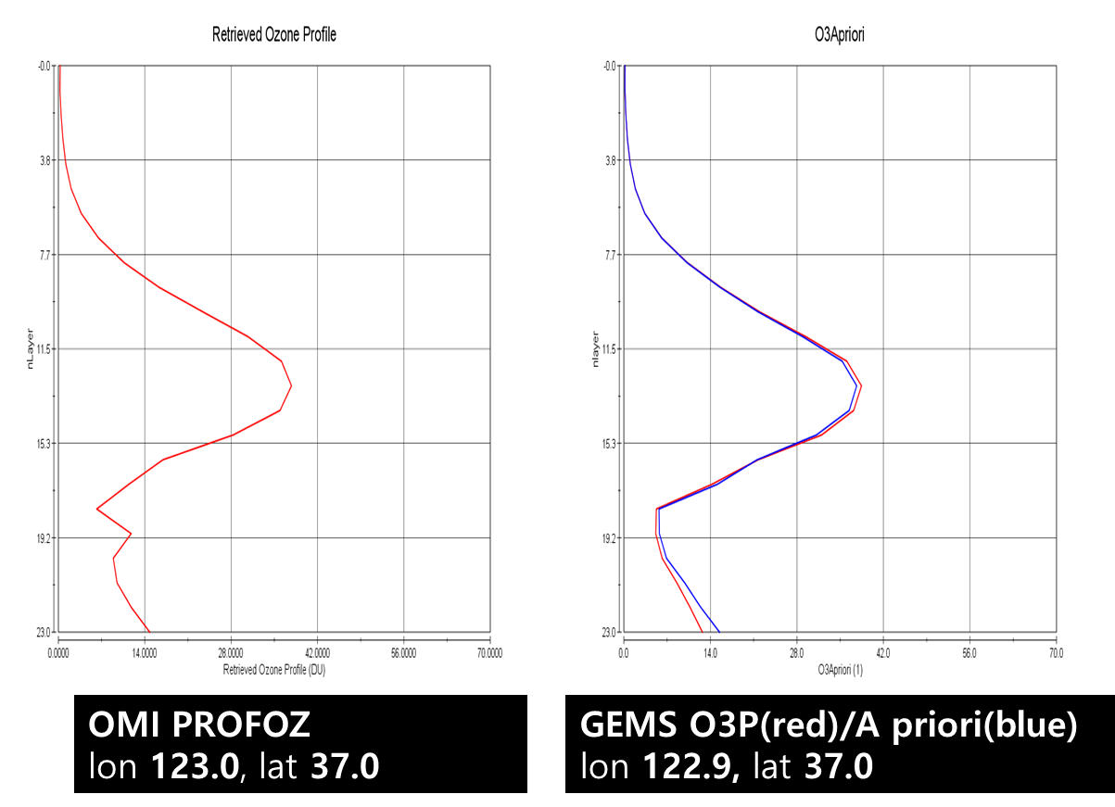
Status of GEMS products
03
☯ Total O3: developed base on TOMS v9.0
- using 312, 317, 331nm
- similar spatial distribution
- high correlation, low difference
☯ O3 profile: based on OE, yield 24 vertical layers
- using 310*(300)~340nm
* Reduce stray light effect
- similar vertical shape
- On going study about improvement for tropopause
☯ to efficient GEMS has four observation coverages(FC, FW, HE, ND)
☯ Among 20 products, 8 types of observation image services including total O3 were started on 22th Mar.
☯ Tropospheric and stratospheric ozone are expected to be released as image in next year.

Slide 37
04
Release plan of GEMS image
No. | Products |  | Unit | Release date
1 | Aerosol | AOD | - | Mar. `21
2 |  | Single Scatter Albedo | - | Oct. `21
3 |  | Aerosol Index | - | Oct. `21
4 |  | Aerosol Effective Height | km | `22
5 | O3 | Total Ozone | DU | Mar. `21
6 |  | Stratospheric Ozone | DU | `22
7 |  | Tropospheric Ozone | DU | `22
8 | Surface reflectance | Surface Reflectance | - | `22
9 | Cloud | Cloud Centroid Pressure | hPa | Oct. `21
10 |  | Effective Cloud Fraction | - | Mar. `21
11 |  | Cloud Radiance Fraction | - | Oct. `21
12 | VOCs | HCHO | molec/cm2 | `22
13 |  | CHOCHO | molec/cm2 | `22
14 | NO2 | Tropospheric NO2 | molec/cm2 | `22
15 |  | Total NO2 | molec/cm2 | Mar. `21
16 | SO2 | SO2 | molec/cm2 | Mar. `21
17 | UV | UV index | - | Oct. `21
18 |  | Plant response rate | - | Mar. `21
19 |  | DNA damage rate | - | Mar. `21
20 |  | Vitamin D production rate | - | Mar. `21

Slide 38


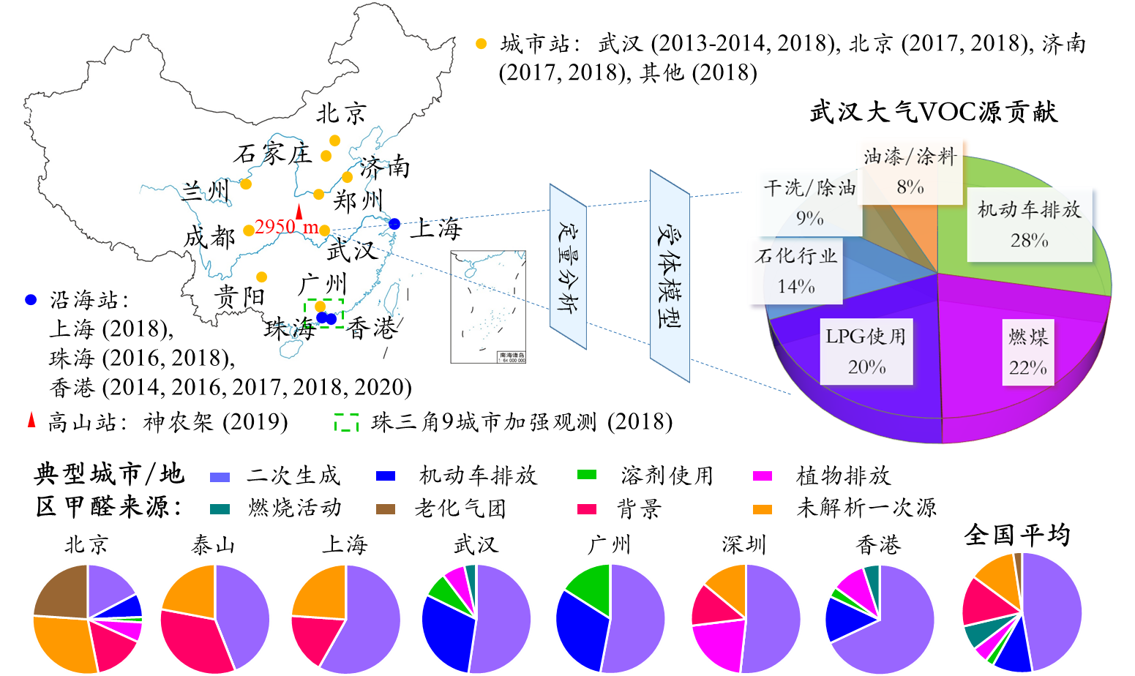
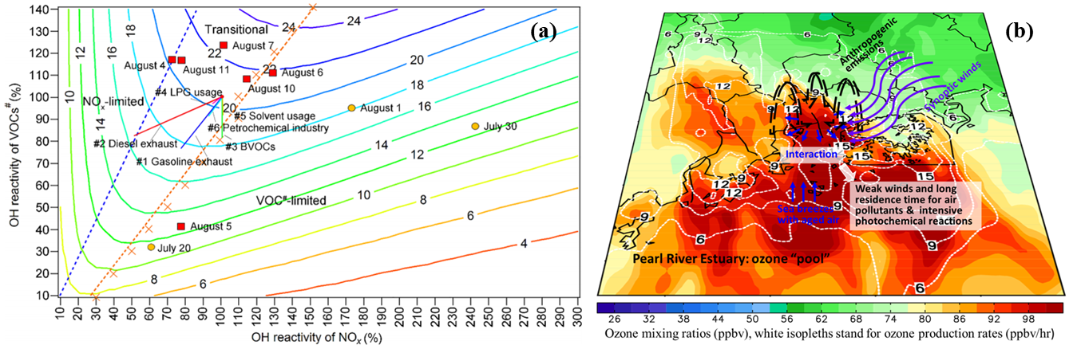
Self-Introduction
Xiaopu Lyu, PhD
Research Assistant Professor
The Hong Kong Polytechnic University
Observation and Modelling of Atmospheric Reactive Organic Carbon and Secondary Products
ORCID: https://orcid.org/0000-0002-3306-1008
Total citation > 1,100 (h index: 18)
Possible contributions:
VOC data at more than 20 Chinese cities;
In-situ photochemical modelling with MCM;
WRF-Chem modelling.

Slide 39


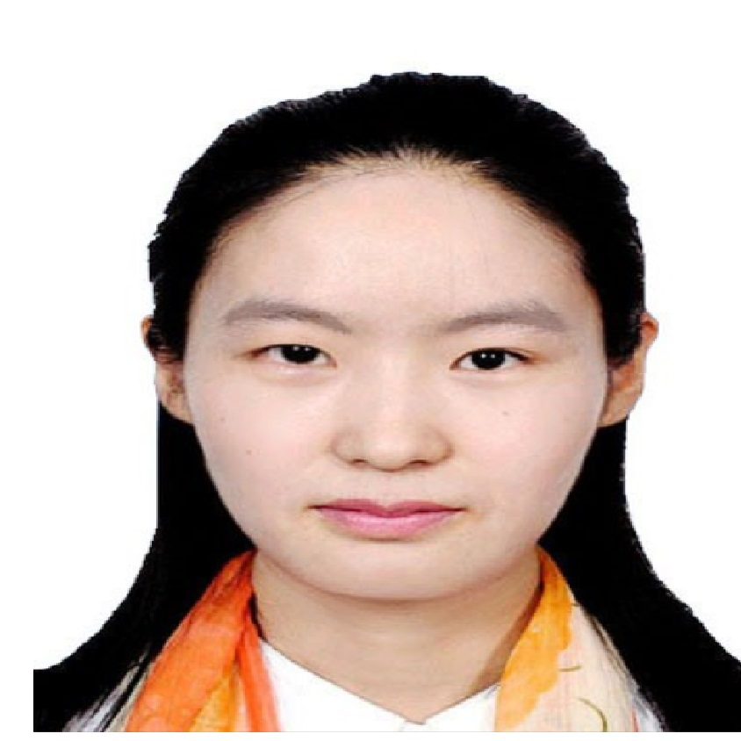











Prof. GUO’s group
Professor Hai GUO
Research Assistant Professor
HKPU Postdoc
Fellow
HKPU Postdoc Fellow
PhD Student
Reactive organic carbon & secondary products
Air pollution & health
Indoor physics
Ozone chemistry
PhD Student
PhD Student
PhD Student
PhD Student
PhD Student
Ozone chemistry & dynamics
Acidic ultrafine particle
Organic aerosol
Organic aerosol
Ozone chemistry
PhD Student
PhD Student
Research Assistant
Research Assistant
Research Assistant
Ozone chemistry & dynamics
Ozone chemistry & dynamics
Ozone chemistry
Indoor physics
Organic aerosol

Slide 40


Introduction to CMA/CAMS group
TOAR-II EAWG Kick-off Meeting, 13 May 2021
Xiaobin Xu
Chinese Academy of Meteorological Sciences
China Meteorological Administration

Slide 41
Group members
Dr. Xiaobin Xu (xiaobin_xu@189.cn)
Leader of Reactive Gases Group, CAMS
Participated in TOAR-I (coauthor: Database, Metrics, Health, Vegetation, Climate)
Dr. Junli Jin (jinjl@cma.gov.cn)
Deputy director, Center for Atmosphere Watch and Services of CMA,CMA Meteorological Observation Center
Participated in the analysis of long-term O₃ measurements from Mt. Waliguan and regional GAW sites in China
Dr. Wanyun Xu (xuwy@cma.gov.cn)
Member of Reactive Gases Group, CAMS
Participated in the analysis of long-term O₃ measurements from Mt. Waliguan and regional GAW sites in China

Slide 42
Potential contributions to TOAR-II
Process data from CMA/CAMS sites
Analyze data from CMA/CAMS and other organizations/ EA countries
Coauthor TOAR-II/EAWG publications
Note: Long-term O₃ data from CMA sites should be submitted by a CMA-designated institution. Official communication with CMA is necessary.

Slide 43
Overview of research activities of ACAP
Development of emission inventory
Regional Emission inventory in ASia
（REAS）
Regional Emission inventory in Asia
for Persistent Organic Pollutants
（REAS-POP）
Elaboration of inventory
Atmospheric observation in Japan and East Asian countries
Spatiotemporal trend analysis of
precipitation, gas and aerosol pollutants
Source apportionment by using receptor
model (CMB, PMF, PSCF)
Wet and dry deposition evaluation of
nitrogen and sulfur substances
Integrated analysis of observation and model
Providing input data
Model analysis
Spatiotemporal distribution of
acidic substances, O3, PM2.5,
PAHs, etc.
Source analysis of acidic
substances, O3, PM2.5, PAHs,
etc.
Model Inter-Comparison Study
for Asia (MICS-Asia)
Integrated analysis of atmospheric trends and impacts
Elaboration of model
Impact analysis caused by air pollution
Soil and vegetation impact study
Material flow analysis of sulfur and
nitrogen in catchment
Impact analysis on human health and
agriculture
Research achievements of ACAP
https://www.acap.asia/en/research-achieve/
43

Slide 44
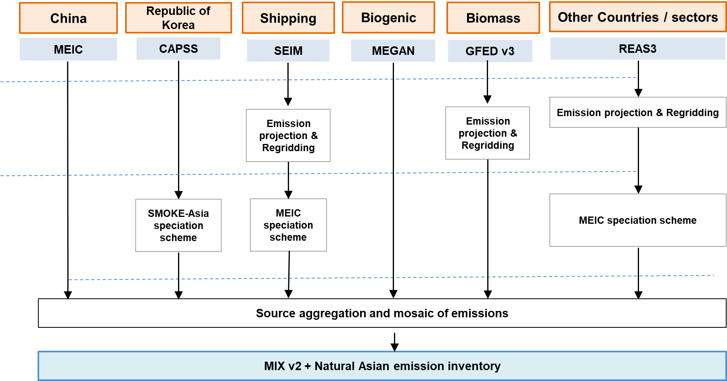
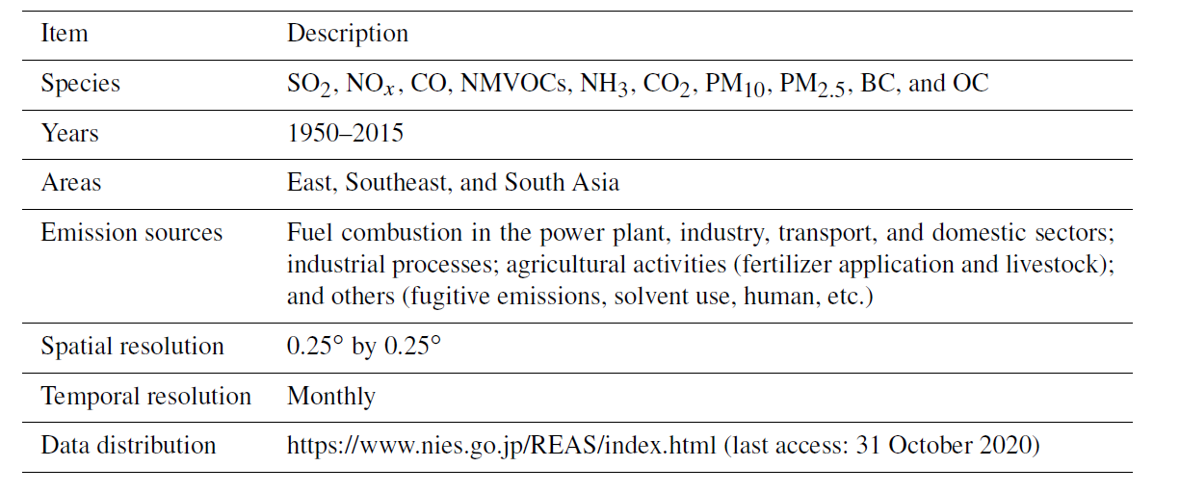
Major Topics of Model Inter-Comparison Study
for Asia (MICS-Asia) Phase IV
Inter-comparison studies for air quality modeling
Inter-comparison studies for air quality and climate change modeling
Development and analysis of emission inventories in Asia
Collection and analysis of observation data in Asia (and conducting own monitoring)
MIXv2 (Mosaic EI)
REAS (Regional Emission inventory in ASia)
Version 3.2 will be updated.
44

Slide 45
Interaction between each working group in MICS IV
Emission inventory working group
Anthropogenic MIX inventory
Biomass burning
Biogenic VOC
Volcanic SO2
Aviation and Navigation
Elaboration of inventory
Observation working group
Collection of observation data in East
Asia (Surface and vertical profile)
Spatiotemporal trend analysis of
precipitation, gas and aerosol pollutants
Implementation of additional
observation campaign if necessary.
Integrated analysis of observation and model
Providing input data
Air quality model working group
Spatiotemporal trend analysis of
gaseous and particulate pollutants
Spatiotemporal trend analysis of
atmospheric depositions
Evaluation of model uncertainties
Integrated analysis of atmospheric trends and impacts
Elaboration of model
Air quality and climate model working group
Elucidation of interaction between air
quality and climate variations.
Sharing the outcomes with other
international organization (e.g. EANET,
TFHTAP, UNEP, WMO etc,)
45

Slide 46
Activity of observation working group in 2021-2022
Asking for key researchers of MICS-Asia for nomination of observation working group. Preparation of the detailed work plan of MICS-Asia Phase IV.
Preparation of the observation data catalog in East Asia via opened databases. Update of 2020 EANET observation data and announcement of user registration.
Discussing with the air quality model working group and the air quality and climate model working group how to implement measurement-model fusion in East Asia.
Collaboration with TOARII East Asia Focus Working Group and arrangement of sharing the observation data in East Asia.

Slide 47


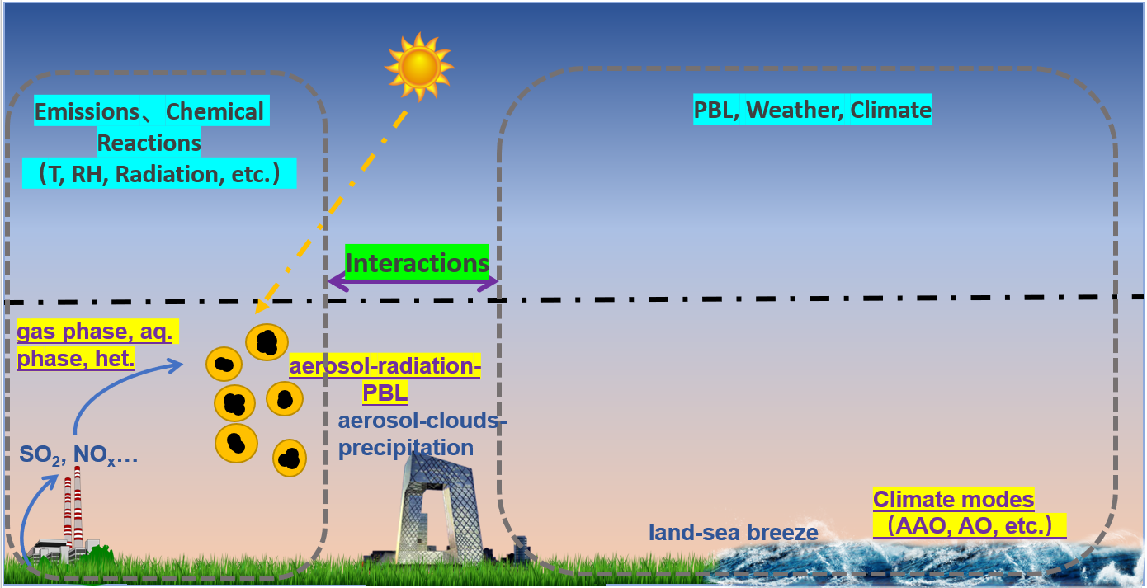
Gao Group for Air Quality, Health, and Climate (GGAHC)
at Hong Kong Baptist University
Professional Preparation
Postdoctoral Fellow, Harvard University
Ph.D. in Chemical Engineering, University of Iowa, USA
B.S. in Atmospheric Physics, Nanjing University of Information Science & Technology, China
Meng GAO (高蒙)
Assistant Professor
Department of Geography
Hong Kong Baptist University
Email: mmgao2@hkbu.edu.hk

Slide 48
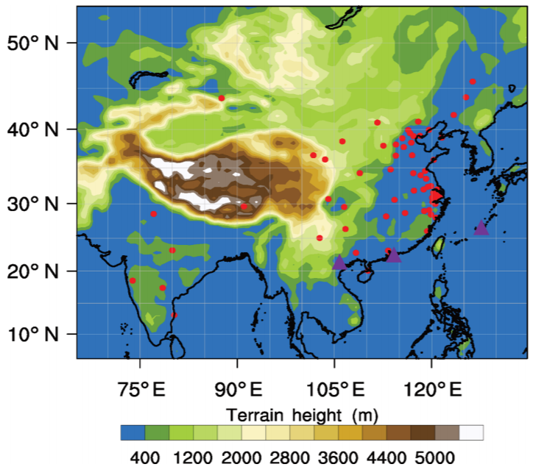
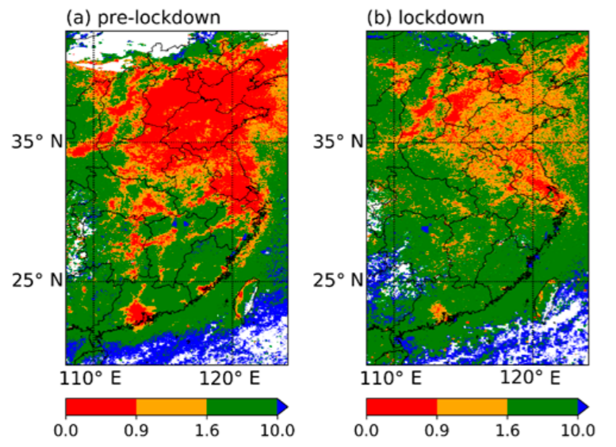
Gao Group for Air Quality, Health, and Climate (GGAHC)
at Hong Kong Baptist University
Potential contribution to TOAR-II
WRF-Chem or WRF-GC model to understand the influences of precursors, transport, etc.
Statistical methods (machine learning, chemical data assimilation) to fuse ozone data from multiple sources
Gao et al., 2020
Liu et al., 2021

Slide 49
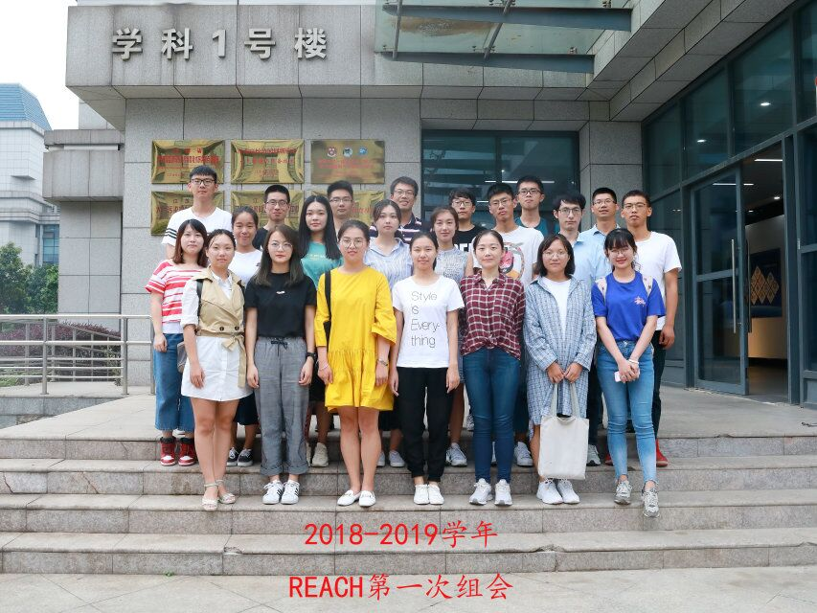

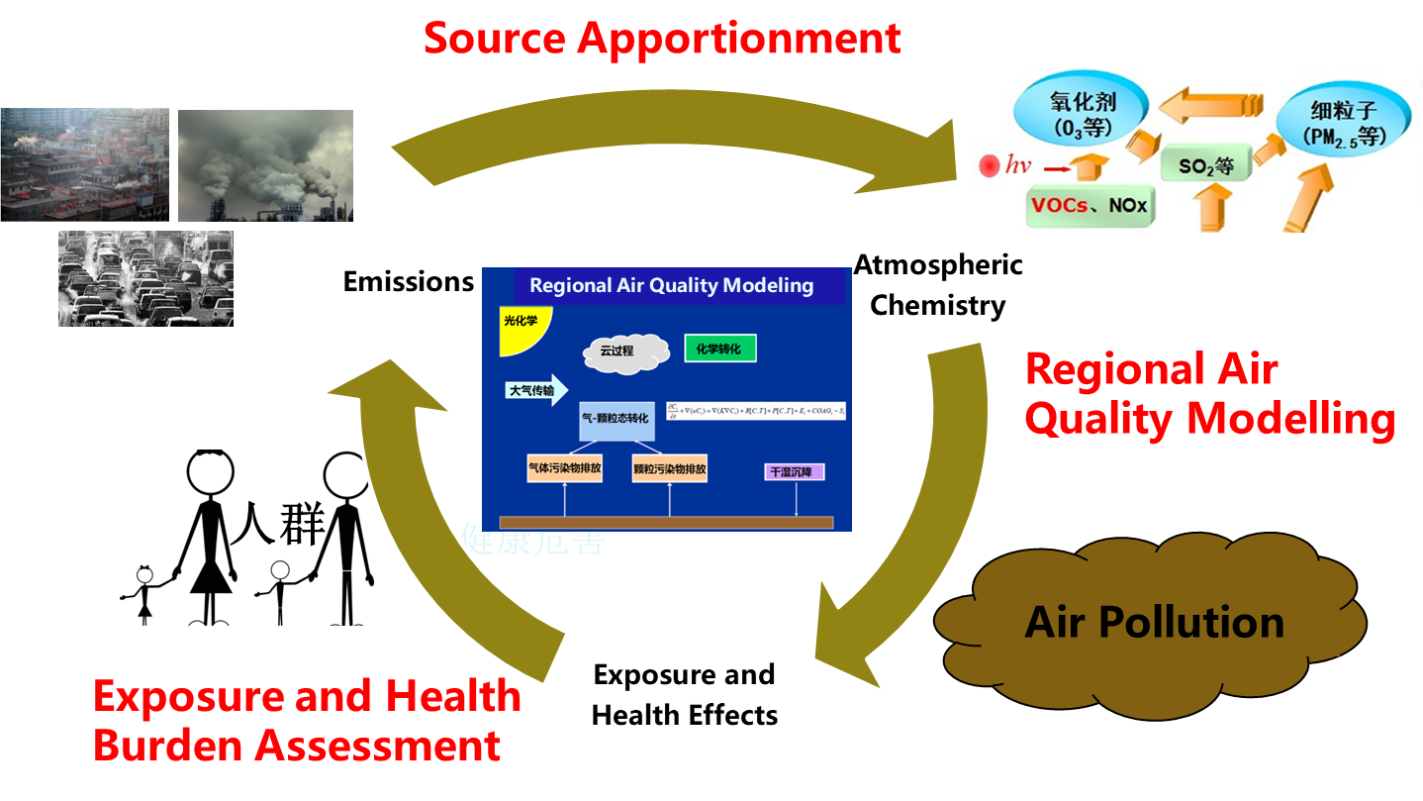
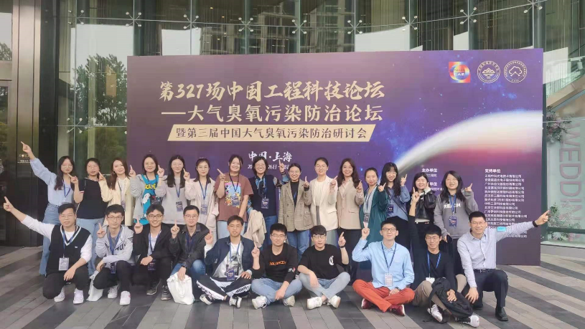

I am leading REACH group @NUIST
(Research for Energy, Air Quality, Climate, and Health)

Slide 50
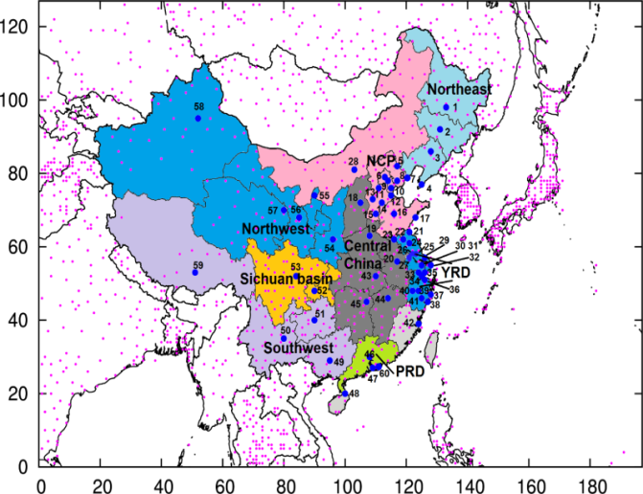
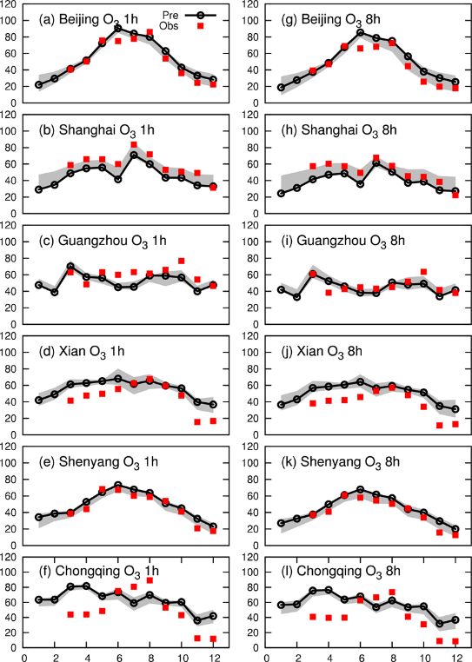
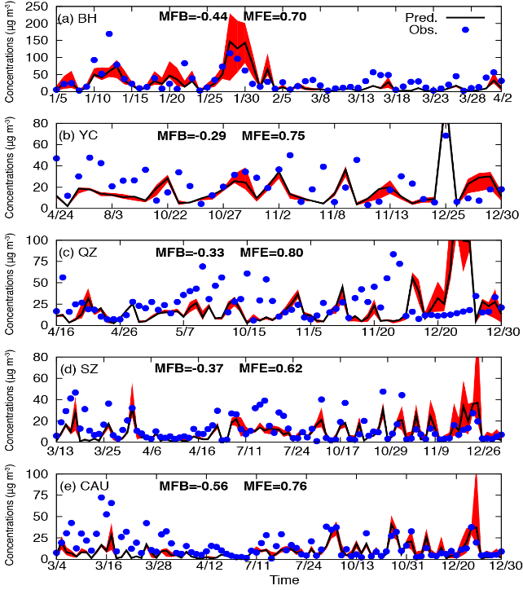
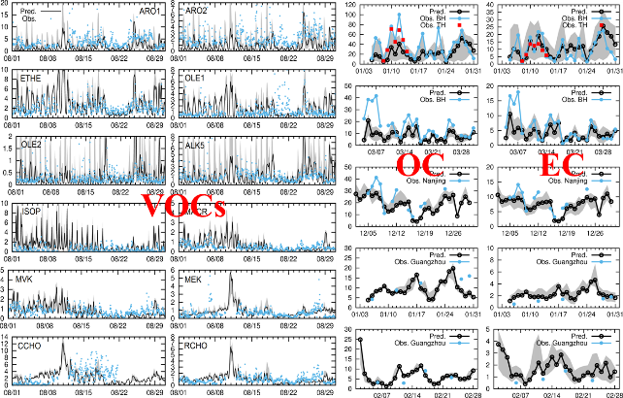
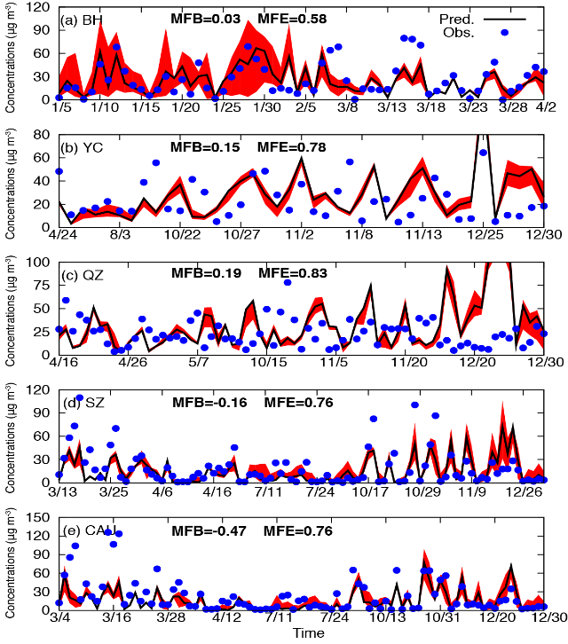
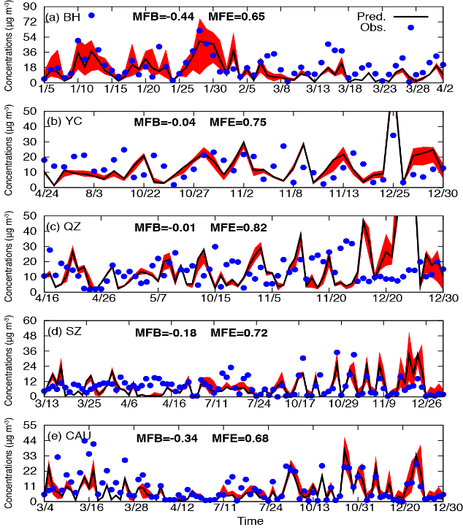
We have CMAQ prediction results in 2013-2018
Domain: China
Grid Resolution: 36km
WRFv4.0
MEICv1.3+REAS2.1+MEGAN2.1+FINN
CMAQ v5.2
SO₂ het. formation Zhang et al., (2015), Hu et al. (2017)
NO₂ het. formation Zheng et al. (2015)
GLY/MGLY → SOA Fu et al., (2018), Ying et al. (2014)
HO₂ uptake by PM_{2.5} surface Li et al. (2018), Xue et al. (2014)
Shi et al. SoTE, 2017
Hu, et al., 2017, ACP
Hu, et al., 2016, ACP

Slide 51

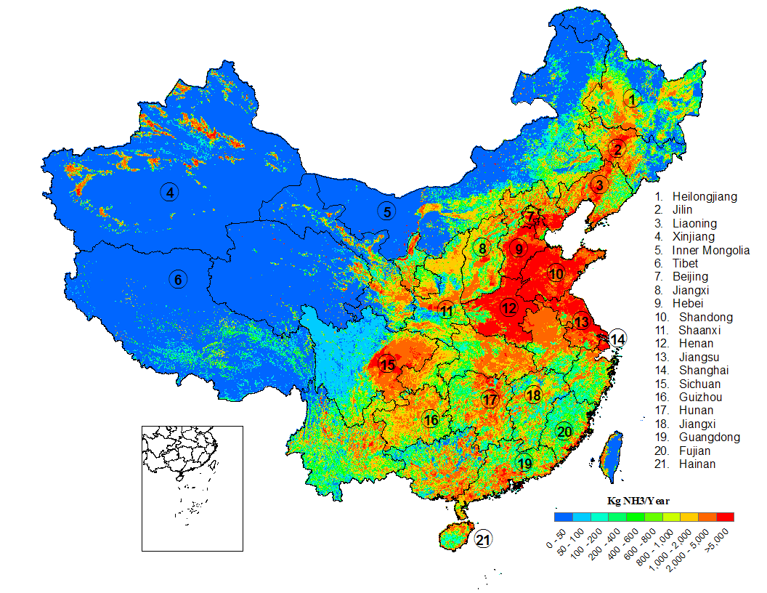
Atmospheric Chemistry & Physics Modeling Group at Nanjing University
Development of high-resolution emission inventories
Improving chemical transport model in China
Xin Huang
Associate Professor
School of Atmospheric Sciences
Nanjing University
Email: xinhuang@nju.edu.cn
ammonia emission intensity (1km×1km)
EDUCATION & EMPLOYMENT
Bachelor of Engineering
2005-2009 School of Environmental Science & Engineering, Shanghai Jiao Tong University
Doctor of Philosophy
2009-2014 College of Environmental Sciences & Engineering, Peking University
Research Assistant Professor
2014- School of Atmospheric Sciences, Nanjing University
Air pollution and the interaction with PBL/weather/climate

Slide 52
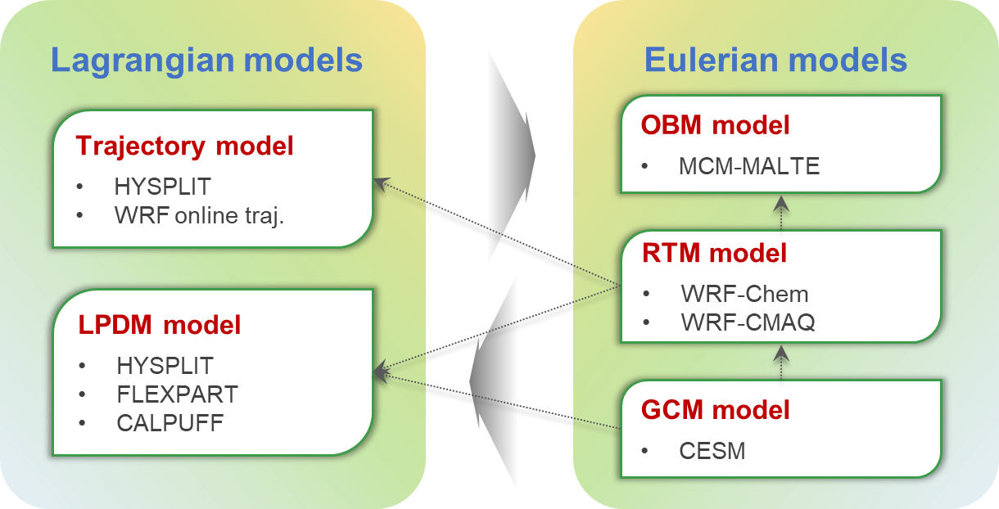

Atmospheric Chemistry & Physics Modeling Group at Nanjing University
Models
Observations
Aggravating O₃ pollution in eastern China despite strict emission control
Using LPDM model and WRF-Chem model to identify the impacts from
Emission/Urbanization
Chemistry
Meteorology
Stratosphere-to-troposphere transport
Wang et al. 2019

Slide 53




Self-Introduction
Yiming Liu (刘一鸣)
Education:
2018.6, Doctor’s degree, Sun Yat-sen University
Work experience:
2018.8-2020.12 Postdoc, Hong Kong Polytechnic University
(Advisor: Prof. Tao Wang)
2021.1-Now Assistant Professor, Sun Yat-sen University
Assistant Professor
School of Atmospheric Science
Sun Yat-sen University
Zhuhai, China
Research interest: Regional air quality modeling (CMAQ, WRF-Chem, CAMx)
Ozone trend in China and its meteorological and emission drivers
Anthropogenic chlorine emission and its impact
Sea salt emission and its impact
Liu & Wang, 2020 @ ACP
Liu et al., 2015 @ AAQR
Liu et al., 2018 @ ACP; Hong et al., 2020 @ STE

Slide 54

Possible Contribution
Modeling data contribution
Model: WRF (3.9.1) – CMAQ (5.2.1)
Domain: South China, Southeast Asia, and South China Sea (Pearl River Delta region as the center)
Resolution: 27/9/3 km
Time: 2013-Now (can be longer)
Emissions: Anthropogenic emission, sea salt emission, Biomass burning emission, biogenic emission,
Chemical boundary conditions: Geos-Chem (will collaborate with Dr. Xiao Lu)
Anthropogenic emission
Pearl River Delta region
Biomass burning emission
Sea salt emission

Slide 55











Mohd Talib Latif
Atmospheric Chemistry and Air Pollution Research group
Universiti Kebangsaan Malaysia
MT Latif
L Ju Neng
MSM Nadzir
MCG Ooi
N Mohd Hanif
M Othman
HHA Hamid
M Sahani
MIA Wahab

Slide 56







NE SW
CAQMS in GKL
Low-cost sensor

Slide 57


THANK YOU
Current Project
Composition of VOCs as ozone precursors
Assessing the impact of global temperatures on surface ozone climate change penalty in Malaysia
https://www.ukm.my/talib/
NSL Hawari
H Mahidin

Slide 58
5. Open discussion

